Slide 1
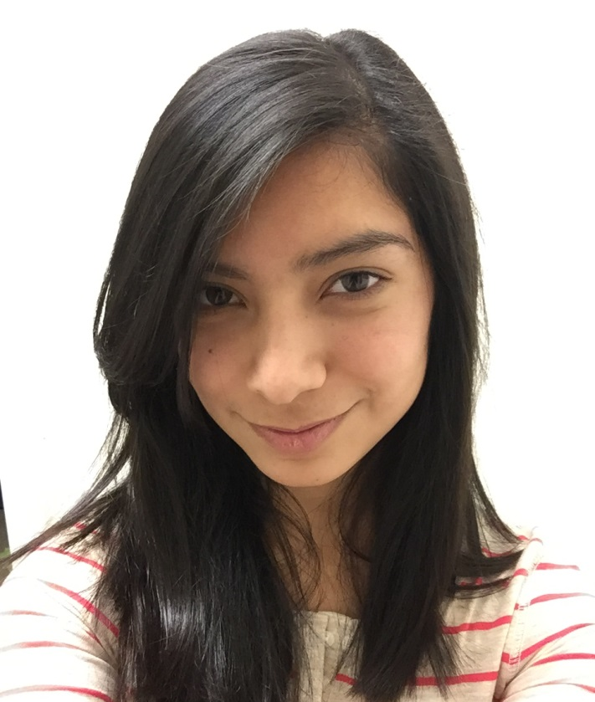
Virginia Aguilar- Meza

Slide 2
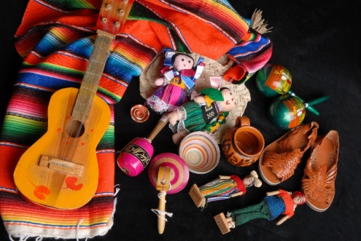
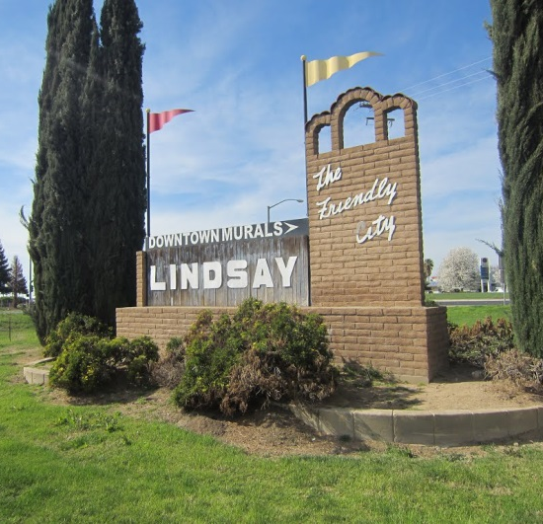
About Me
Born and raised in Lindsay
Come from a Hispanic decent
Raised with by a widowed mother
6 siblings
Introverted yet dedicated

Slide 3
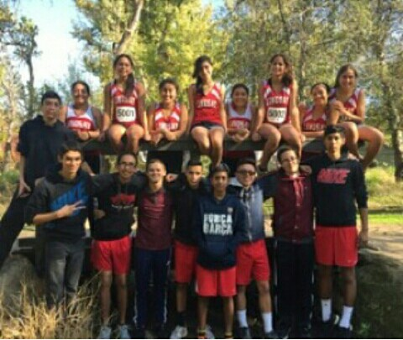
High School Experience
Clubs:
REAP
CSF
National Spanish Honors Society
FBLA
Anime Club
Sports:
Track and Field (sophomore & junior year)
Cross Country (junior & senior year)

Slide 4
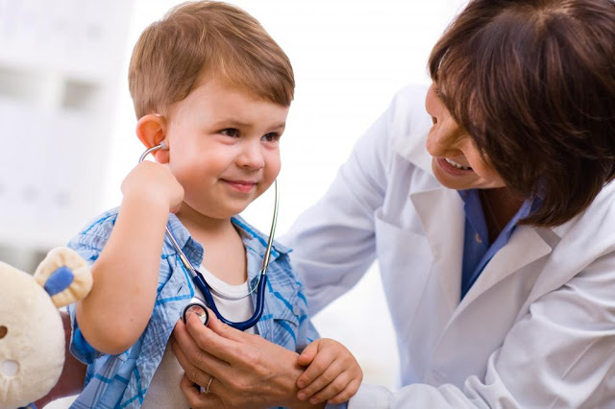
Job Shadow
Local Physician’s Assistant
Same job description and journey as a PNP
Realized the job suited me perfectly because I love helping others

Slide 5
Pathway
Foreign Language (Spanish)
Most Americans speak Spanish
Translator
Help others communicate
Everyone receives help

Slide 6
Post-High School Plans
CSU Stanislaus
Major: Pre-nursing
ACCEPTED!!!!!!!!!
Reasons:
Local
More affordable
Large acceptance rate
Small class sizes
95% passing rate in NCLEX-RN
First generation to go to college
Short term goals: Bachelor’s in Science of Nursing
Long term goals: Become a certified Pediatric Nurse Practitioner

Slide 7
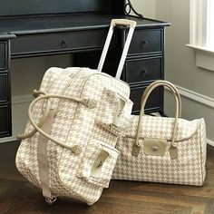
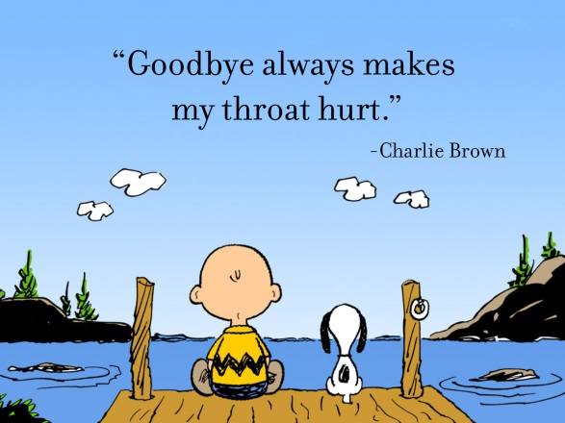
Leaving LHS
Nostalgic
LHS made me more confident in myself
Thought I had no chance for college
Helped me discover my flaws, yet who I wanted to be
PBS system taught me that no matter I can achieve in what ever I wanted as long as I work hard for it

